Slide 1
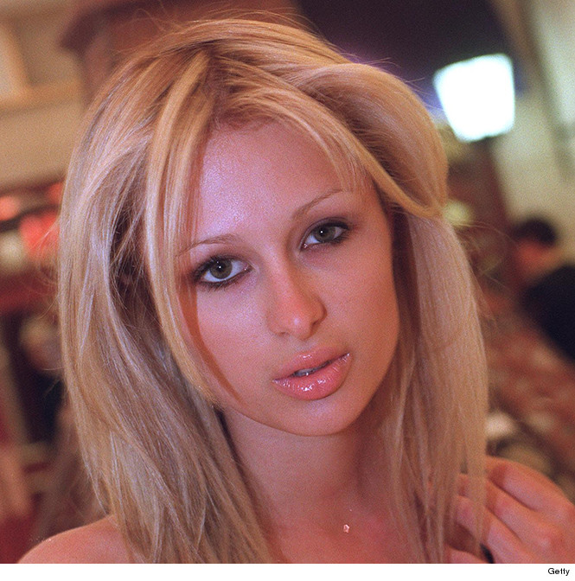

Wants & needs
What’s the difference?

Slide 2

How bad do you NEED this?

